Slide 1

Timetable generator app
By Tushar Sudeep, darshan melkote and raj s dhanure

Slide 2
Introduction
The Timetable Generator App is an innovative solution designed to simplify the scheduling process for teachers and educators. This user-friendly application allows users to create personalized and efficient timetables based on individual courses, activities, and preferences. Key features of the app include:
1. User-Friendly Interface: An intuitive design ensures that users can easily navigate the app, making timetable creation simple and quick.
2. Customizable Timetable: Users can input their subjects, class timings, and extracurricular activities. The app intelligently organizes this information to generate a cohesive timetable that fits their lifestyle.
3. Conflict Resolution: The app automatically detects and resolves scheduling conflicts, ensuring that users are not double-booked and can manage their time effectively.
4. Ability to schedule auxiliary tasks: Non-teaching tasks such as lunch duty or administrative tasks can be automatically scheduled.
5. Offline capability: Users can access their schedules without the internet connectivity.
6. Sharing Options: Students can easily share their timetables with classmates or family members, promoting collaboration and study group organization.
By integrating these features, the Timetable Generator App aims to reduce stress associated with planning and enable users to have a punctual life.

Slide 3
requirements
Software requirements:
1. Python3
2. Web Browser (Chrome, Edge, Safari, Opera, Firefox)
3. PostgreSQL
4. Python Libraries:
a) Flask
b) Bootstrap
c) Random
Hardware requirements:
1. 2GB disc space
2. 2GB RAM
3. x86 or AMD core with at least 1 GHz (64-bit)

Slide 4
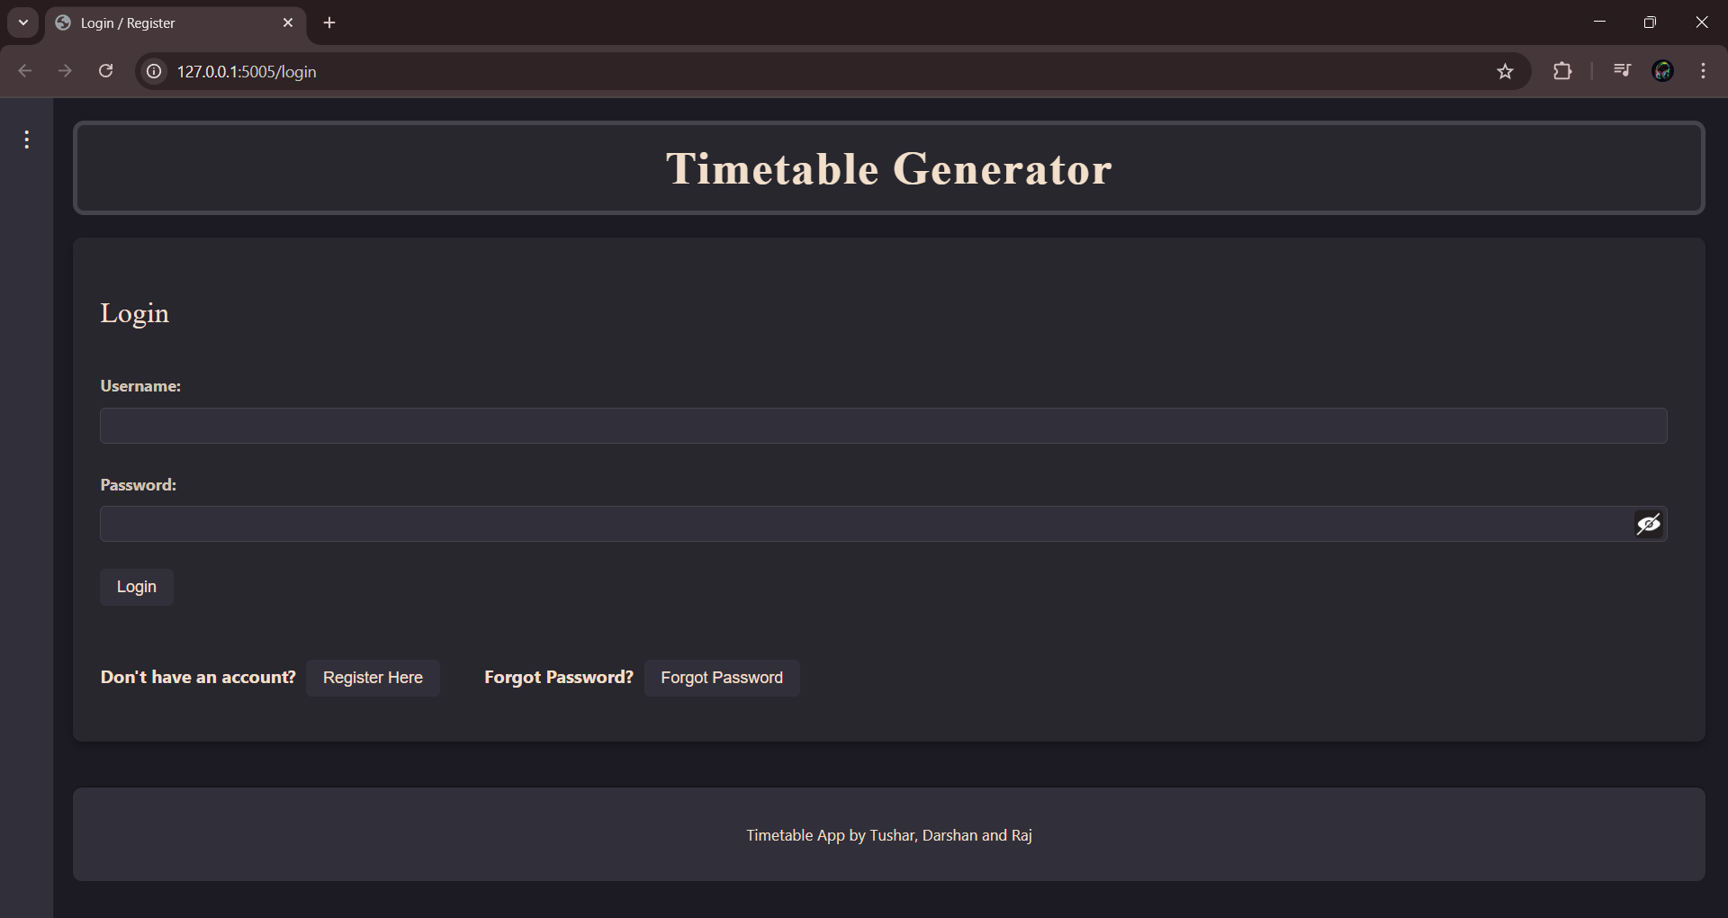
Login page

Slide 5
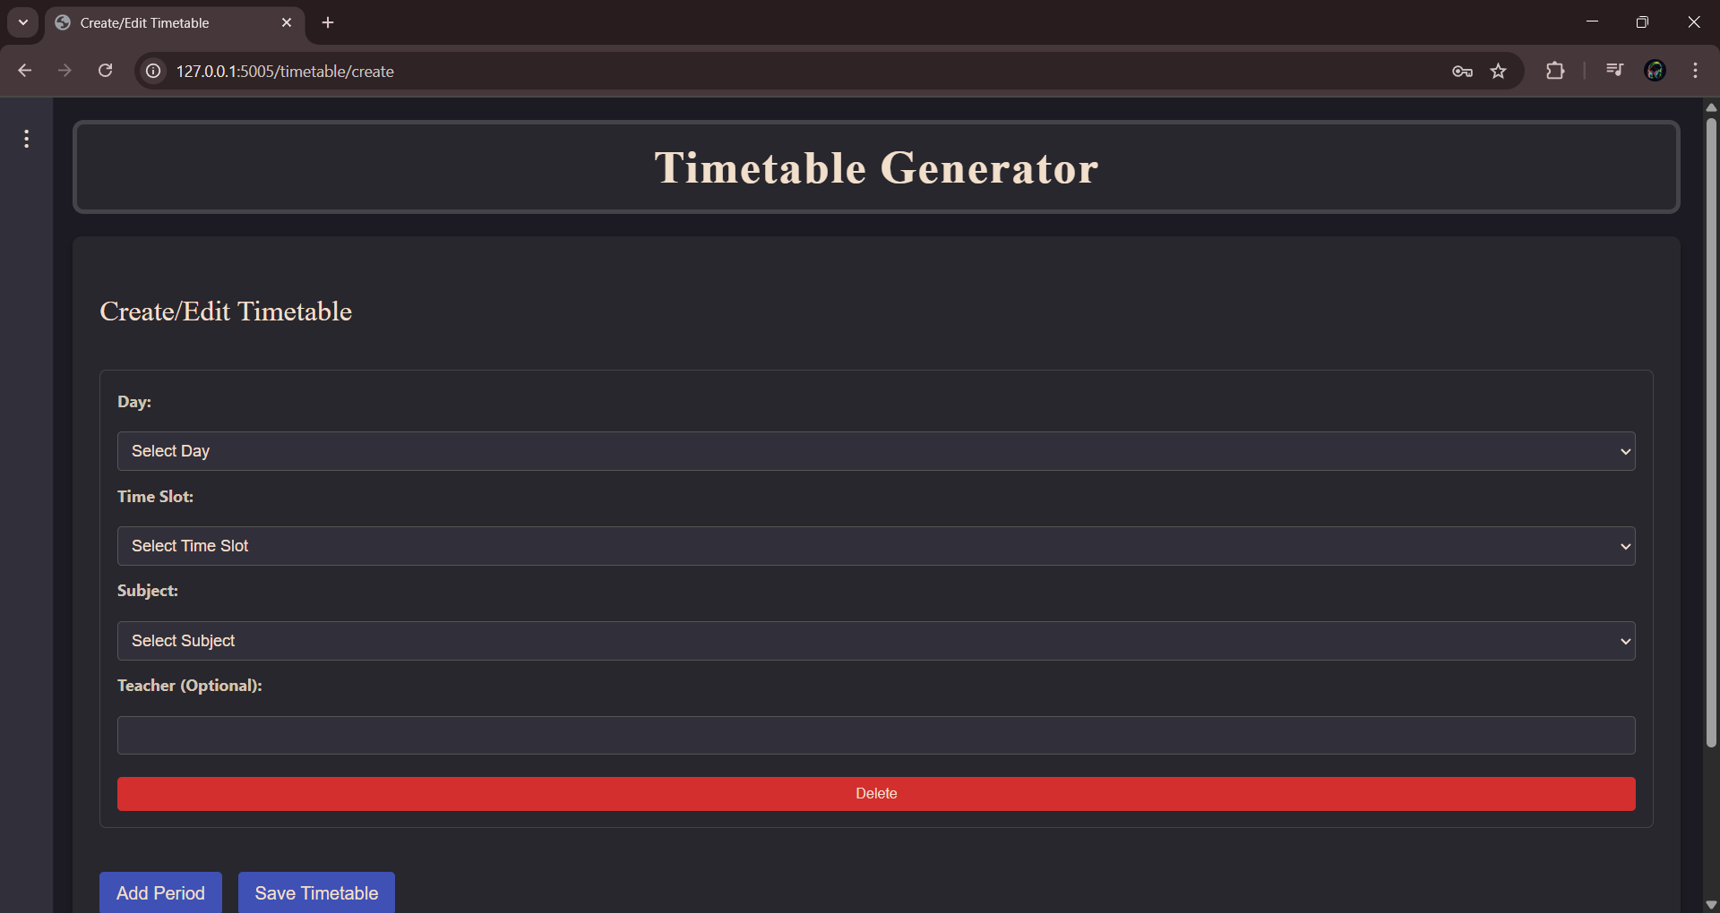
View timetable page

Slide 6
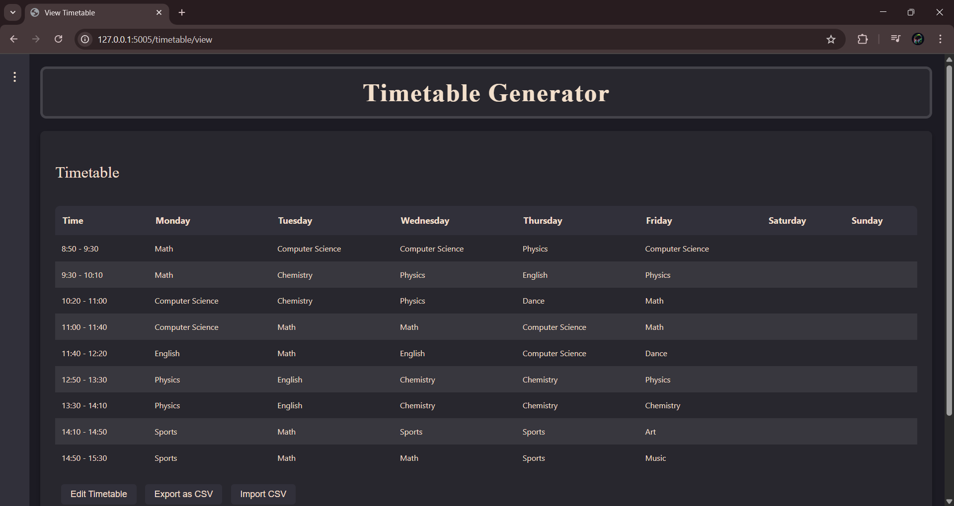
Sample timetable

Slide 7

Thank You

